Slide 1
CIS 9660 – Data Mining for Analytics
Week 8 Unsupervised learning
Prof. Arturo Castellanos
CIS Department Office: VC11-229

Slide 2
Agenda
Midterm
Group project
Malcom Gladwell’s On Spaghetti Sauce video comments
Unsupervised learning
Open questions about the project if you started looking at datasets

Slide 3
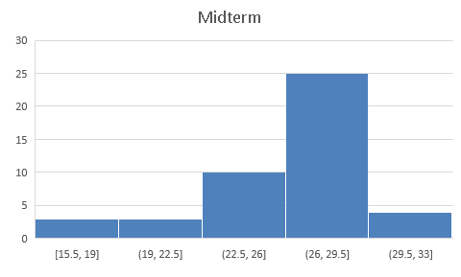
Midterm – 30 points
Mean | 26.35555556
Median | 27.5

Slide 4
Project (Phase I) – Due 11/9
Deliverable: Document with the following (1 page)
Description of the case study
What is the business problem?
What is the data available
Description of data
Number of instances + Variables + target variable
Feel free to schedule a Zoom call with me if you want to discuss your ideas/progress.

Slide 5
Unsupervised Learning
Learning useful structure without labeled classes, optimization criterion, feedback signal, or any other information beyond the raw data

Slide 6
Data Mining Tasks: Pattern Discovery
Segmentation /Clustering/Profiling
Group customers into distinct segments
Summarization/Rules
Purchases of related products

Slide 7
Unsupervised Classification
inputs
grouping
cluster 1
cluster 2
cluster 3
cluster 1
cluster 2
Unsupervised classification: grouping of cases based on similarities in input values

Slide 8

Recommendation Systems
Source: http://www.techradar.com/news/television/best-netflix-series-25-great-netflix-tv-shows-1288230

Slide 9
Why segment?
Gain greater understanding of customers
Design and develop new product/services and product bundles tailored to each segment’s characteristic
Offer tailored rewards and incentives
Prioritization of marketing initiatives

Slide 10


Customer Segmentation

Slide 11
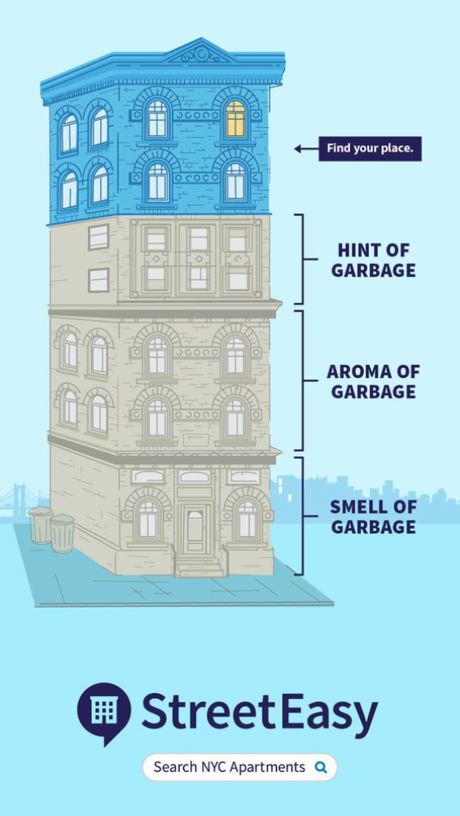

“Find your place campaign”

Slide 12
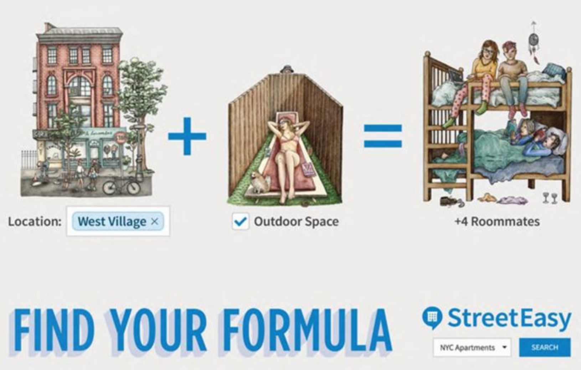
“Find your formula campaign”

Slide 13
What is Clustering?
A technique to find “natural grouping” in the data
No target outcome (unsupervised learning)

Slide 14
What is Cluster Analysis?
Finding groups of objects such that the objects in a group will be similar (or related) to one another and different from (or unrelated to) the objects in other groups
Inter-cluster distances are maximized
Intra-cluster distances are minimized

Slide 15
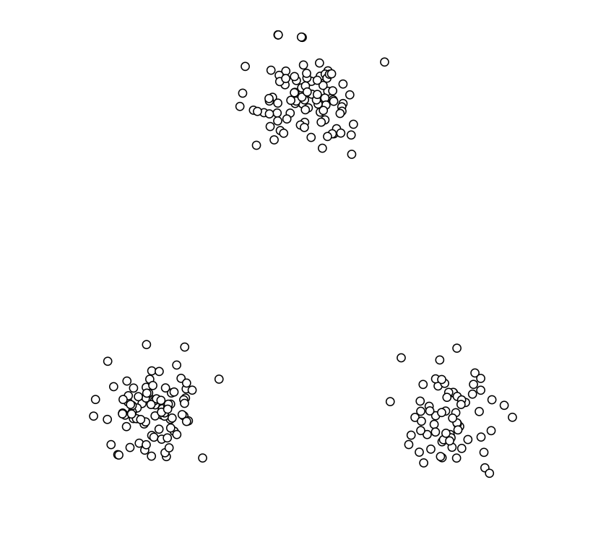
How many clusters? (Using K-means)

Slide 16
K-means algorithm
1. Select inputs.
2. Select k cluster centers.
3. Assign cases to closest center.
4. Update cluster centers.
5. Re-assign cases.
6. Repeat steps 4 and 5
until convergence.

Slide 17
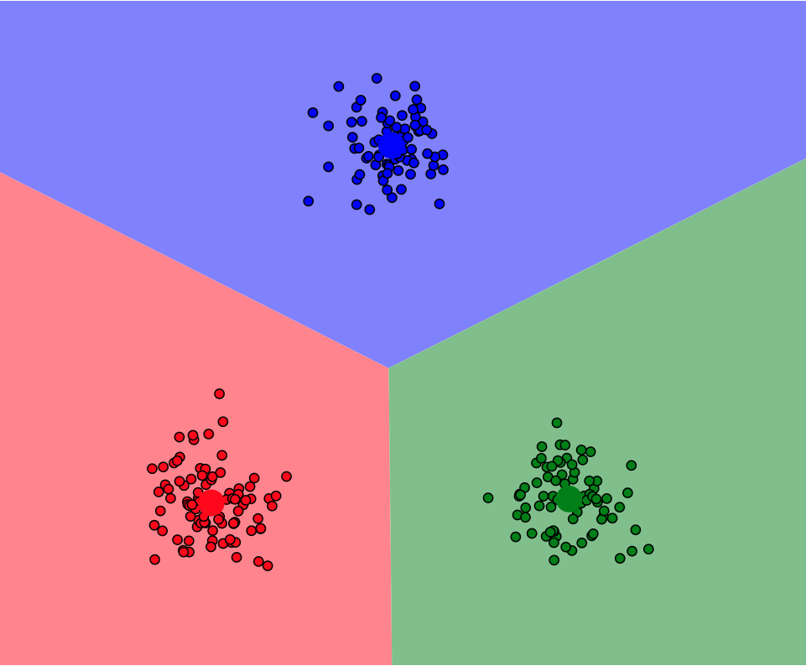
Interactive demo:
Link

Slide 18
Example: Public Utilities
Goal: find clusters of similar utilities
Data: 22 firms, 8 variables
Fixed-charge covering ratio
Rate of return on capital
Cost per kilowatt capacity
Annual load factor
Growth in peak demand
Sales
% nuclear
Fuel costs per kwh

Slide 19
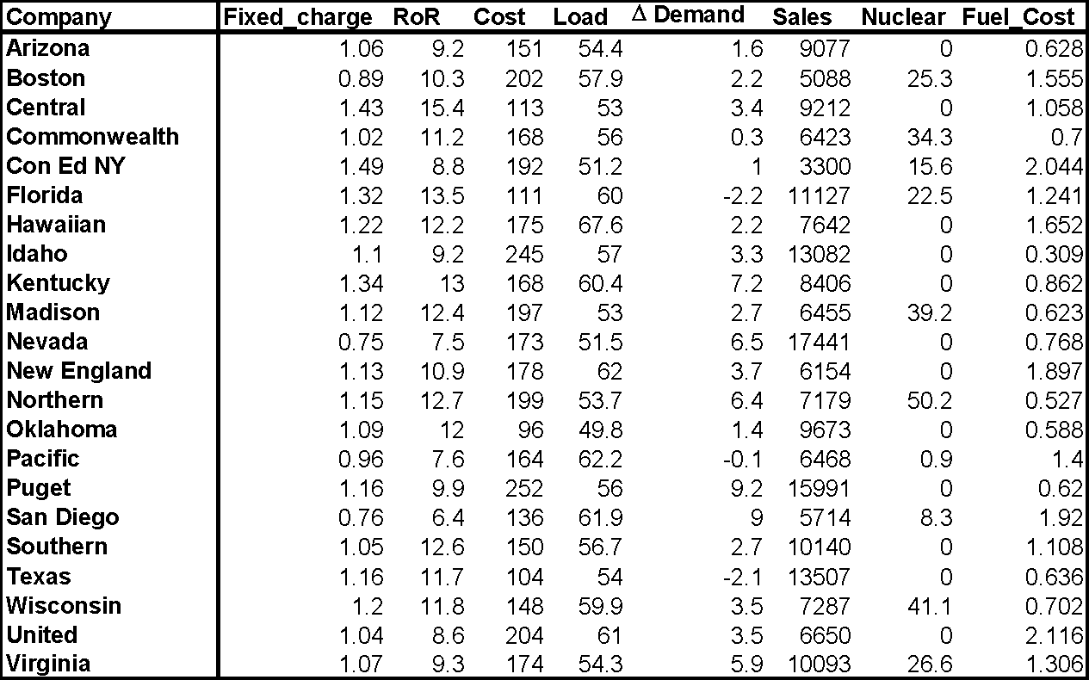

Slide 20
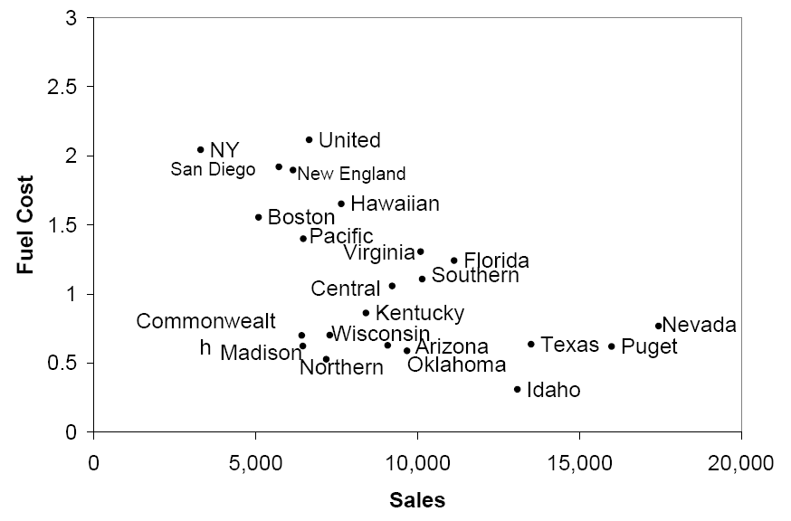
Sales & Fuel Cost: 3 rough clusters can be seen
High fuel cost, low sales
Low fuel cost, high sales
Low fuel cost, low sales

Slide 21
Extension to More Than 2 Dimensions
In prior example, clustering was done by eye
Multiple dimensions require formal algorithm with
A distance measure
A way to use the distance measure in forming clusters
We will consider two algorithms: hierarchical and non-hierarchical

Slide 22
Measuring Distance
Between records
Between clusters
Euclidean Distance is most popular:

Slide 23
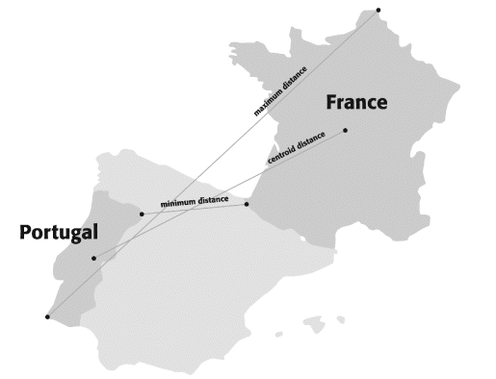
Measuring distance between two clusters
Two distance measures:
Distance between data points (measured by the euclidean distance of normalized scores for numerical variables).
Distance between clusters
Min
Max
Centroid
Source: Chapter 15 (Textbook: Schmueli, Bruce, and Patel 2016 ‘Data Mining for Business Analytics’)

Slide 24
Compute Distance Matrix for Utility Pairs
utilities_df = pd.read_csv('Utilities.csv')
# set row names to the utilities column
utilities_df.set_index('Company', inplace=True)
# compute Euclidean distance
d = pairwise.pairwise_distances(utilities_df,
metric='euclidean')
pd.DataFrame(d, columns=utilities_df.index,
index=utilities_df.index)

Slide 25
Output: Distance Matrix for Utility Pairs
Partial Output
Company Arizona Boston Central Commonwealth NY
Company
Arizona 0.000000 3989.408076 140.402855 2654.277632 5777.167672
Boston 3989.408076 0.000000 4125.044132 1335.466502 1788.068027
Central 140.402855 4125.044132 0.000000 2789.759674 5912.552908
Commonwealth 2654.277632 1335.466502 2789.759674 0.000000 3123.153215
NY 5777.167672 1788.068027 5912.552908 3123.153215 0.000000

Slide 26
Normalizing
Problem: Raw distance measures are highly influenced by scale of measurements
Solution: normalize (standardize) the data first
Subtract mean, divide by std. deviation
Also called z-scores
Or Rescale to 0/1 range
Subtract the minimum
Divide by range

Slide 27
Example: Normalization
For 22 utilities:
Avg. sales = 8,914
Std. dev. = 3,550
Normalized score for Arizona sales:
(9,077-8,914)/3,550 = 0.046

Slide 28
Code for Normalizing then Computing Distance
# using scikit-learn*
utilities_df_norm = utilities_df.apply(preprocessing.scale,
axis=0)
# using pandas*
utilities_df_norm = (utilities_df -
utilities_df.mean())/utilities_df.std()
# compute normalized distance based on Sales and Fuel Cost
utilities_df_norm[['Sales', 'Fuel_Cost']]
d_norm = pairwise.pairwise_distances
(utilities_df_norm[['Sales', 'Fuel_Cost']],
metric='euclidean')
pd.DataFrame(d_norm, columns=utilities_df.index,
index=utilities_df.index)
*scikit-learn uses population std. dev. (divide by n), pandas uses sample std. dev. (divide by n-1)

Slide 29
Distance Matrix - Normalized
Partial output
Company Arizona Boston Central Commonwealth NY
Company
Arizona 0.000000 2.010329 0.774179 0.758738 3.021907
Boston 2.010329 0.000000 1.465703 1.582821 1.013370
Central 0.774179 1.465703 0.000000 1.015710 2.432528
Commonwealth 0.758738 1.582821 1.015710 0.000000 2.571969
NY 3.021907 1.013370 2.432528 2.571969 0.000000

Slide 30
Hierarchical vs. Non-hierarchical Clustering
Two general types of clustering algorithms are:
Non-hierarchical methods, such as k-means. Using a pre-specified number of clusters, the method assigns observations to each cluster. These methods are generally less computationally intensive and are therefore preferred with very large datasets.
Hierarchical methods can be either agglomerative or divisive. Agglomerative methods begin with n clusters and sequentially merge similar clusters until a single cluster is obtained.
Hierarchical methods are especially useful when the goal is to arrange the clusters into a natural hierarchy.

Slide 31
Applying the idea of clustering to Classification tasks
K-NN algorithm

Slide 32
Nearest-Neighbor Classifiers
Requires three things
The set of labeled records
Distance Metric to compute distance between records
The value of k, the number of nearest neighbors to retrieve
To classify an unknown record:
Compute distance to other training records
Identify k nearest neighbors
Use class labels of nearest neighbors to determine the class label of unknown record (e.g., by taking majority vote)

Slide 33
Definition of Nearest Neighbor
K-nearest neighbors of a record x are data points that have the k smallest distances to x

Slide 34
Nearest Neighbor Classification
Compute distance between two points:
Euclidean distance
Determine the class from nearest neighbor list
Take the majority vote of class labels among the k-nearest neighbors
Weigh the vote according to distance
weight factor, w = 1/d²

Slide 35
Nearest Neighbor Classification…
Choosing the value of k:
If k is too small, sensitive to noise points
If k is too large, neighborhood may include points from other classes

Slide 36
Nearest Neighbor Classification…
Scaling issues
Attributes may have to be scaled to prevent distance measures from being dominated by one of the attributes
Example:
height of a person may vary from 1.5m to 1.8m
weight of a person may vary from 90lb to 300lb
income of a person may vary from $10K to $1M

Slide 37
Nearest Neighbor Classification…
Selection of the right similarity measure is critical:
1 1 1 1 1 1 1 1 1 1 1 0
0 0 0 0 0 0 0 0 0 0 0 1
vs
0 1 1 1 1 1 1 1 1 1 1 1
1 0 0 0 0 0 0 0 0 0 0 0
Euclidean distance = 1.4142 for both pairs

Slide 38
Nearest neighbor Classification…
k-NN classifiers are lazy learners since they do not build models explicitly
Classifying unknown records are relatively expensive
Can produce arbitrarily shaped decision boundaries
Easy to handle variable interactions since the decisions are based on local information
Selection of right proximity measure is essential
Superfluous or redundant attributes can create problems
Missing attributes are hard to handle

